Slide 1

SIDDAGANGA INSTITUTE OF TECHNOLOGY TUMAKURU-572103
Distributed Version Control System
Bivek Shrestha 1SI14IS014

Slide 2
Contents
Introduction
Literature Survey
Main Concepts
Basic and Advanced Actions
Git Workflow
Applications
Limitations
Conclusions
Bibliography

Slide 3
Version Control
category of software tools that help a software team manage changes to source code over time.
records changes to a file or set of files over time so that you can recall specific versions later.

Slide 4

Version Control(contd.)

Slide 5
Purposes of Version Control
enables multiple people to simultaneously work on a single project.
chooses when to share those changes with the rest of the team.
when two people make conflicting edits to the same line of a file, then the version control system requests human assistance in deciding what to do.
gives access to historical versions of your project.
If you make a mistake, you can roll back to a previous version.

Slide 6
Distributed Version Control System
These systems do not necessarily rely on a central server to store all the versions of a project’s files.
DVCS replicates the repository of files onto each user’s machine.
Each replicated repository has a full history of the project with all of the metadata of the original.

Slide 7
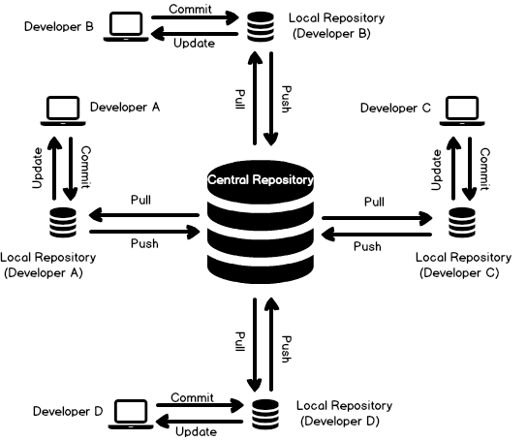
Distributed Version Control System(contd.)

Slide 8
Traditional System
Based on Centralized Version Control.
Tools are SVN,CVS.
Works on a Client-Server relationship.
The repository is located at one place and provides access to many clients.
As soon as you commit, it is possible for your co-workers to update and to see your changes.
For others to see your changes, 2 things must happen:
You commit
They update

Slide 9
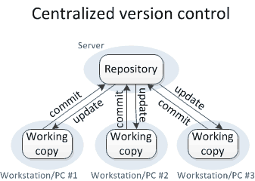
Centralized Version Control(contd.)

Slide 10
Existing System
Based on Distributed Version Control.
Do not necessarily rely on a central server to store all the versions of a project’s files.
every developer “clones” a copy of a repository and has the full history of the project on their own hard drive.
This copy (or “clone”) has all of the metadata of the original.

Slide 11
Advantage over Centralized Version Control
pushing and pulling changesets is extremely fast because the tool only needs to access the hard drive, not a remote server.
Everything but pushing and pulling can be done without an internet connection.
share changes with one or two other people at a time if they want to get some feedback before showing the changes to everyone.
Committing new changesets can be done locally without anyone else seeing them.
Once you have a group of changesets ready, you can push all of them at once.

Slide 12
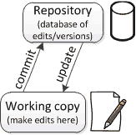
Main Concept
Repository
Version control uses a repository (a database of changes) and a working copy(checkout) where you do your work.
When you are happy with your edits, you commit your changes to a repository.
Can update your working copy to incorporate any new edits or versions that have been added to the repository since the last time you updated.

Slide 13
Basic Actions
Add: Put a file into the repo for the first time, i.e. begin tracking it with Version Control.
Revision: What version a file is on (v1, v2, v3, etc.).
Head: The latest revision in the repo.
Check out: Download a file from the repo.
Check in: Upload a file to the repository (if it has changed). The file gets a new revision number, and people can “check out” the latest one.

Slide 14
Basic Actions(contd.)
Update/Sync: Synchronize your files with the latest from the repository. This lets you grab the latest revisions of all files.
Revert: Throw away your local changes and reload the latest version from the repository.
push: send a change to another repository (may require permission)
pull: grab a change from a repository

Slide 15

Advanced Actions
Branching
possibility is that different users made edits simultaneously.
In that case, the version history splits and then merges again.

Slide 16
Diff/change/delta
Finding the differences between two files. Useful for seeing what changed between revisions.
Implementation of Patience Diff.
Based on the longest common subsequence problem.
LCS for input Sequences “ABCDGH” and “AEDFHR” is “ADH” of length 3. LCS for input Sequences “AGGTAB” and “GXTXAYB” is “GTAB” of length 4.

Slide 17
Algorithm
If(input1[i]=input2[j]){
T[i][j]=T[i-1][j-1]+1;
Else
T[i][j]=max(T[i-1][j],T[i][j-1]);
}

Slide 18
Working process
 |  | a | b | c | d | a | f
 | 0 | 0 | 0 | 0 | 0 | 0 | 0
a | 0 | 1 | 1 | 1 | 1 | 1 | 1
c | 0 | 1 | 1 | 2 | 2 | 2 | 2
b | 0 | 1 | 2 | 2 | 2 | 2 | 2
c | 0 | 1 | 2 | 3 | 3 | 3 | 3
f | 0 | 1 | 2 | 3 | 3 | 3 | 4
a,b,c,f

Slide 19
Other Terminogies
Merge (or patch): Apply the changes from one file to another, to bring it up-to-date. For example, you can merge features from one branch into another. There are occasions when multiple versions of a file need to be collapsed into a single version.
Uses cosequential merge Algorithm.
Tools like Bazaar uses K-way Merge which uses Selection tree.

Slide 20
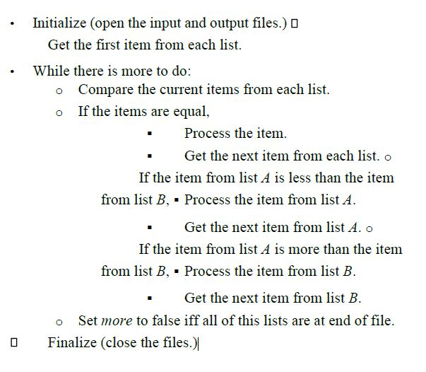
Cosequential Merge

Slide 21

K-way Merge Algorithm

Slide 22
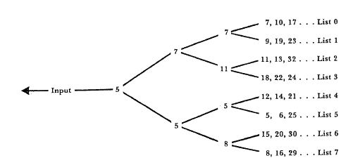

Slide 23
Conflict
When pending changes to a file contradict each other (both changes cannot be applied).

Slide 24
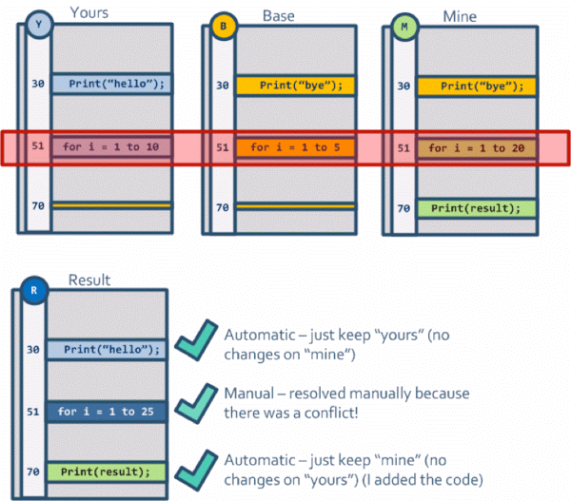
Conflict(contd.)

Slide 25
Resolve: Fixing the changes that contradict each other and checking in the correct version.
Locking: Taking control of a file so nobody else can edit it until you unlock it. Some version control systems use this to avoid conflicts.
Breaking the lock: Forcibly unlocking a file so you can edit it. It may be needed if someone locks a file and goes on vacation (or “calls in sick” the day Halo 3 comes out).

Slide 26
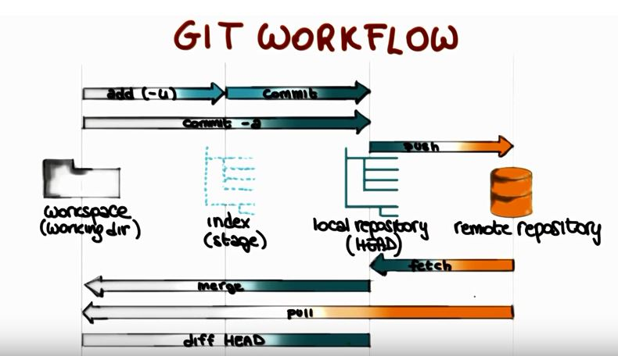
GIT Workflow

Slide 27
Applications
Tools like Git,Mercurial,Bazaar,Monotone have been developed.
Git is used in Web Development Community.
Facebook adopted Mercurial and began work on scaling it to handle their large, unified code repository.
Bazaar used in GUI software to add a graphical interface to the system.
Ubuntu uses Bazaar for Version Control.

Slide 28
Limitations
If your project has a very long history (50,000 changesets or more), downloading the entire history can take an impractical amount of time and disk space.
Working with a lot of binary files requires a huge amount of space, and developers can't do diffs.
File locking doesn’t allow different developers to work on the same piece of code simultaneously. It helps to avoid merge conflicts, but slows down development
DVCS enables you to clone the repository – this could mean a security issue.

Slide 29
Conclusion
Aims to solve a specific problem that programmers face: “storing and sharing multiple versions of code files.”

Slide 30
Bibliography
[1] http://blog.teamtreehouse.com/why-you-should-switch-from-subversion-to-git [2] https://blogs.atlassian.com/2012/02/version-control-centralized-dvcs/
[3] http://kissflow.com/kissu_kissu/git-vs-svn/
[4] https://betterexplained.com/articles/a-visual-guide-to-version-control/
[5] https://homes.cs.washington.edu/~mernst/advice/version-control.html

